Slide 1
PENS AND PRINTERS
PRODUCT SALES ANALYSIS

Slide 2
BUSINESS GOALS
The primary goal is to establish an effective sales strategy for the newly launched product line.
Insights to maintain trust and lasting relationship with the customers.
The company recognizes that the consumer buying behaviour is changing and they aim to adapt their sales
tactics to meet the demands of this new product line hence will like to know the following insights:
○ How many customers were there for each sales approach ?
○ What does the spread of the revenue look like overall and for each sales method?
○ Was there any difference in revenue over time for each of the methods?
○ Based on the data, which method would you recommend we continue to use?

Slide 3
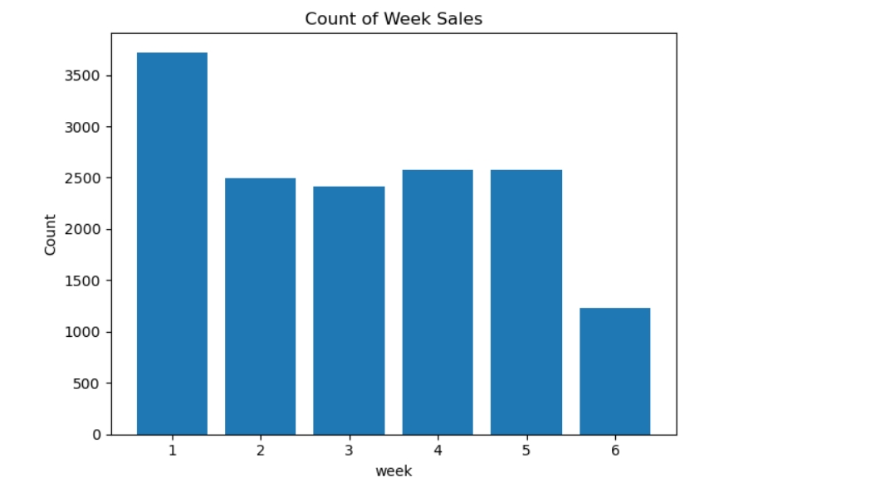
OUTCOMES
Count of weeks by sales
This bar charts shows the count of week by sales. It shows the weeks with the highest and smallest sales. This chart shows that there was high sales in the first week with 24.8%, decreased to 16.6% in the second week, decrease to 16.01% in the third week, later increased to 17.16% in the fourth week and fifth week but the sales reduced drastically to 8.18% in the sixth week.

Slide 4
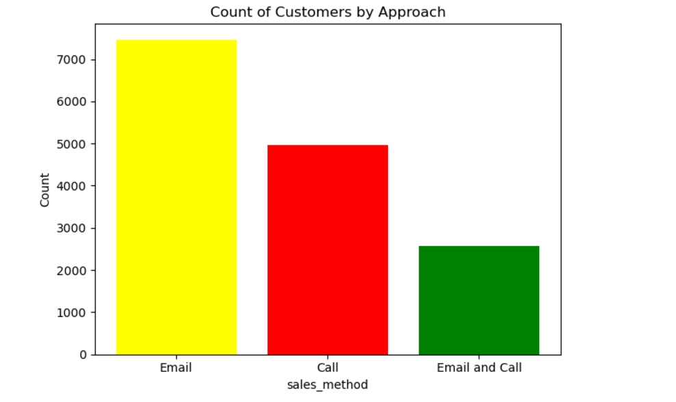
OUTCOMES
Count of Customer by approach
This bar chart shows that the Email method has the highest number of customer order with 7466 order amounting to 49.77% of the total sales while Call method has 4962 order amounting to 33.08% and Email and Call has the lowest customer order with 2572 customer order amounting to 17.15% of the total sales

Slide 5
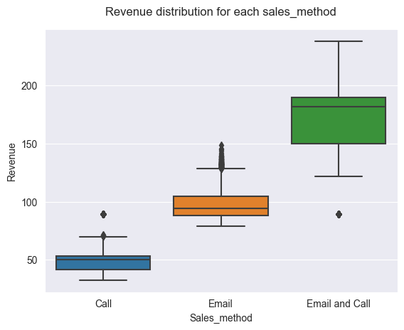
OUTCOMES
Distribution of revenue by each approach
The multiple boxplot represents the distribution of revenue for each sales method.
The boxplot shows that the "Email and Call" sales method has the highest median revenue of 182 USD, with 50% of its revenue between 150 and 190 USD.
This is followed by the Email method and lastly the Call method with the least median revenue sales.

Slide 6
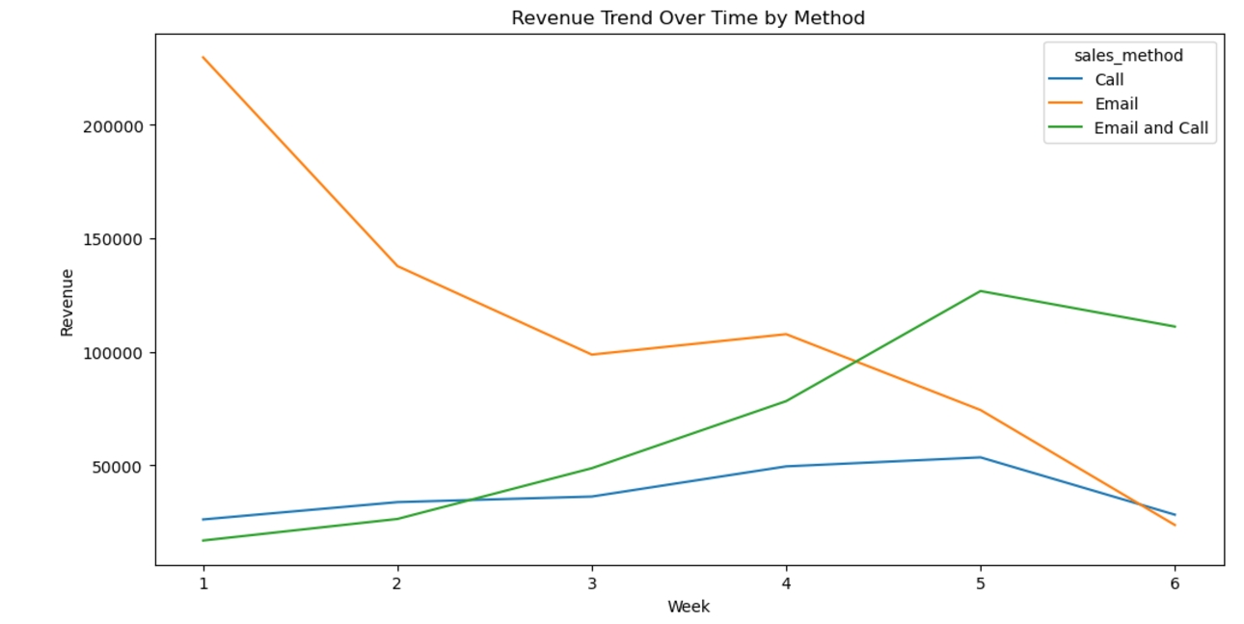
OUTCOMES
Revenue Trend over time by method
Email and Call has the lowest revenue in the first week but increased till the 6th week. The percentage of the increment is 4% to 27% from week 1 to week 6.
Email has the highest revenue in the first week but reduced drastically on the sixth week.
Call has the medium lowest revenue in the first week but increased as weeks pass by but later decreased on getting to the sixth week.

Slide 7
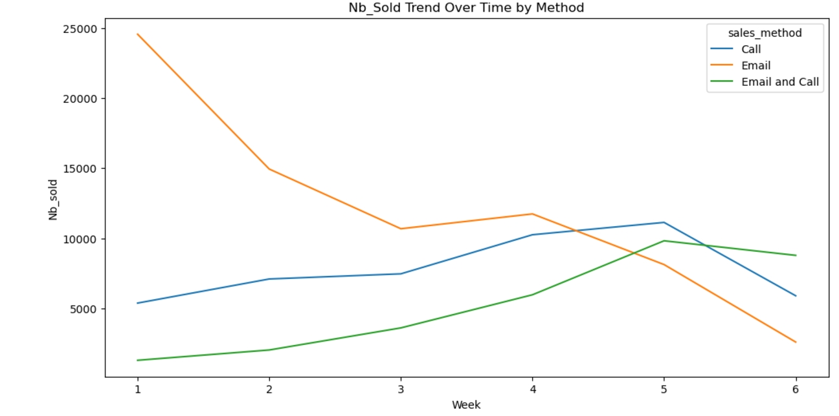
Number of Products sold trend by time by method
Email has the highest number of product sold in week 1 but reduced by week 6.
Email and Call has the lowest number of product sold in week 1 but increased as weeks goes by till week 6.
Call has the medium low number of products sold in week 1 but increased as the weeks pass by but later decreased on getting to week 6.

Slide 8
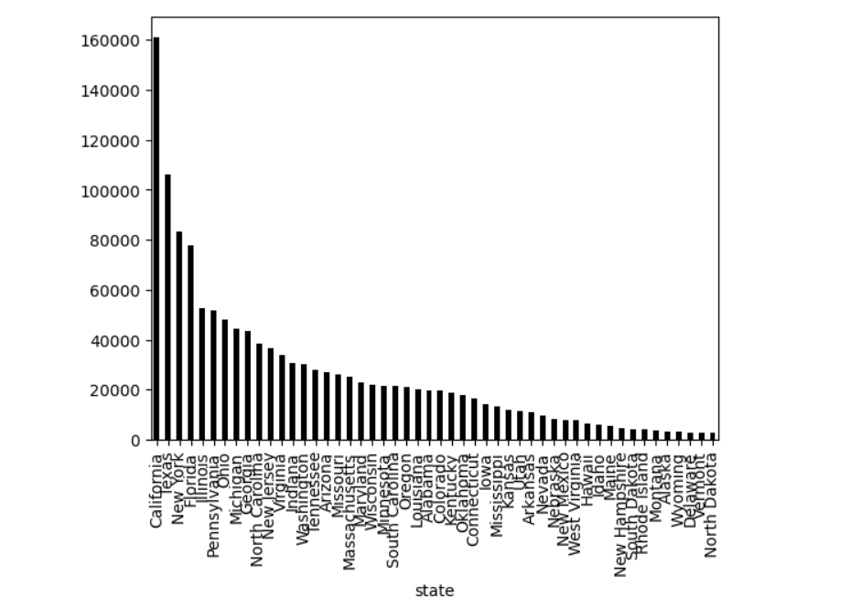
States with the highest revenue
California is the state with the highest revenue, followed by Texas and New York.

Slide 9
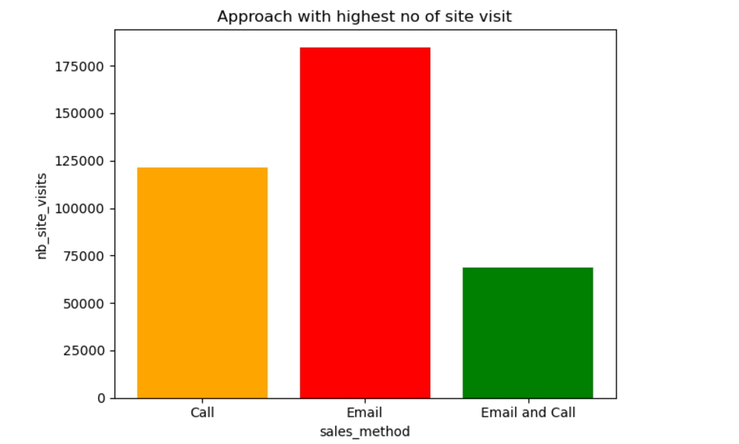
Approach with the highest no of visit.
Email method has the highest number of site visit with 184816
Call has the second most number of site visit with 121191
Email and Call has the lowest number of site visit with 68856.

Slide 10
BUSINESS METRIC
Since the business goal is to adapt the best sales approach to effectively sell the new product line in a way that meets the changing consumer behaviour, I would recommend we use percentage average sales revenue for all sales method as our metric. Although the Email and Call method brought in the most average revenue, The Email method and Call method are less variable, hence the need to track all the sales methods.
Tracking this metric over time can help the business identify trends & patterns and make informed decisions about each sales strategy.
Based on the data for the last 6 weeks, the percentage average sales revenue for the sales methods are:
Email and call = 53.98%
Email = 30.58%
Call = 15.52%

Slide 11
Recommendations
I will recommend the Email and Call method to be used as the revenue generated with this approach increases as time pass by compared to Email that has high revenue in the first week but decreases as time pass by.
I will recommend that the states with the highest revenue should be focused on more so as to get more revenues instead of channelling energy to states where the revenue is low.
Implement customer retention and loyalty programs, especially for customers who have been with us for 10years or more. This will help us to maintain trust and long lasting relationship with our customers.

